Slide 1
Welcome to the POL 101 session on
Political systems model

Slide 2
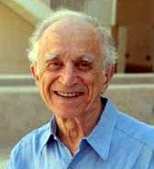

Slide 3
A political system is a human community that successfully claims the monopoly of the legitimate use of physical force within a given territory
-Max Weber-

Slide 4
A system is a set of elements standing in interaction.
-Ludwig von Bertallanfy-

Slide 5
Political systems may be designated as those institutions through which values are authoritatively allocated for society.
- David Easton -

Slide 6
Easton is renowned for his application of systems theory to political science, and for his definition of politics as the "authoritative allocation of value" in ‘A Framework for Political Analysis’ and ‘A Systems Analysis of Political Life’, both published in 1965.

Slide 7
Systems theory in political science is a highly abstract, partly holistic view of politics, influenced by cybernetics. The adaptation of system theory to political science was first conceived by David Easton in 1953.

Slide 8
Political system refers to a phenomena of interaction between formal and informal socio-political and legal institutions in a given society having its impact not only in the domestic sphere but also on internal environments

Slide 9
In simple terms, Easton's behavioural approach to politics, proposed that a political system could be seen as a delimited (i.e. all political systems have precise boundaries) and fluid (changing) system of steps in decision making.

Slide 10
Simplification of Easton’s Systems Model
Step 1. changes in the social or physical environment surrounding a political system produce "demands" and "supports" for action or the status quo directed as "inputs" towards the political system, through political behavior.

Slide 11
Step 2, these demands and supporting groups stimulate competition in a political system, leading to decisions or "outputs" directed at some aspect of the surrounding social or physical environment.

Slide 12
Step 3, after a decision or output is made (e.g., a specific policy), it interacts with its environment, and if it produces change in the environment, there are "outcomes."

Slide 13
Step 4, when a new policy interacts with its environment, outcomes may generate new demands or supports and groups in support or against the policy ("feedback") or a new policy on some related matter.

Slide 14
Step 5, feedback, leads back to Step 1, forming a never-ending cycle.
If the system functions as described, then we have a "stable political system". If the system breaks down, then we have a "dysfunctional political system".

Slide 15
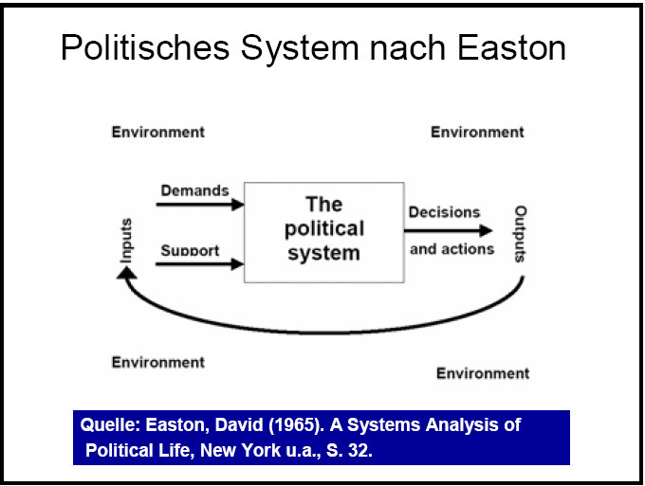

Slide 16
Introduction of David Easton
David Easton, a Canadian political scientist and a distinguished research professor in the department of political science at the university of California, provided the disciplines most widely used definition of politics and is renowned for his application of system theory to the study of political science

Slide 17
Easton wishes to construct an empirically oriented general theory of politics and to that end, he seeks to define the kinds of functions and characteristics of any political system through a systematic frame work for political analysis.

Slide 18
He examines “the basic processes through which a political system, regardless of genetic and specific type, is able to persist as a system of behavior in a world either of stability and change.

Slide 19
Definitions of David Easton
“The system of interaction in any society through which binding or authoritative allocations is made”.
According to Easton, political life is “a system of behavior embedded in an environment to the influence of which the political system itself is exposed and in turn reacts.”

Slide 20
The term “political system” is being used increasingly in the study of comparative politics. Different political scientists have a variety of views upon the definition of political system.

Slide 21
David Easton says that “Political system is authoritative allocation of values but before going into the elaborated definition of the political system, one must know about the terms ‘political’ and ‘system”.

Slide 22
The word `political’ in its literal meanings is that any phenomenon pertains to the study of politics. So politics in its simplest meaning is, ‘practice of government and managing of public affairs.’

Slide 23
The word `system’ implies the interdependence of parts and a boundary of some kind between it and its environment.
Interdependence means that when the properties of one component in a system changes, all the other components and the system as a whole is affected.

Slide 24
The `boundary’ of the political system means that every political system has its bounded frame work in which it performs. In this way it has become easier to understand the meaning of a political system.

Slide 25
Every political system has three fold functions.
1. Entertaining demands
2. Ensuring efficacy
3. Change or development

Slide 26
Demands
David Easton was the first political scientist who analyzed the political system in a unique way and presented a model in which he mentioned that in a political system there were two types of inputs: demand and support.

Slide 27
Demands always arise from the very nature of human personality and society. Demands are aspirations of the people. They want to satisfy their demands. So the political system is asked to cater the demands of the people.

Slide 28
There are generally three sources from where demands originate.
(a) Society
(b) Political elite
(c) International environment
The sources denote that inputs are not only originated at domestic level but also at international level. The political system is supposed to cater to the demands successfully either inwardly or outwardly.

Slide 29
There are four types of demands as shown David Easton.
Demands for goods and services
- These demands focus on wages and hour laws, educational opportunities, recreational facilities, roads and transportation.
Demands for the regulation of behavior
- The demands intend to regulate the behavior of the people such as the provision of public safety, control over markets and labor relations and behaviors pertaining to marriages and family laws.

Slide 30
Demands for participation in the political system
- Such demands focus on right to vote, to hold office in the legislative assemblies, right to have freedom of association and organizing a political party etc.
Demands for communication and information
- Those types of demands remade for the display of majority and power of the political system in the period of chaos or stability. Such inputs demands for affirmation of norms.

Slide 31
Support
Inputs have also further sub divisions and undoubtedly, without support inputs demands are never fulfilled by a political system. It means supports inputs are a coercive force behind the demands input.

Slide 32
Kinds of supports
1 Material supports
Material support relates with the payment of taxes, levying the duties, the provisions of services.
2 Obedience to laws and regulations
Such support intends to obey laws and regulations of the state and assure cooperation with the political elite
3 Participatory support
These supports focus on voting, political decisions and other forms of activity
4 Manifestation of deference
Such supports manifest deference to public authority, symbols and ceremonials.

Slide 33
Epitomizing the whole phenomenon of inputs, it is seen that demands and supports have a stress upon the political system and these two kinds of input pass through a conversion box.

Slide 34
In the conversation box political elite and other different structures discuss those inputs and make decisions and make/ formulate policies for running the political machinery successfully.

Slide 35
OUTPUTS
Decisions
Decisions are output, which come out of the conversion box in the form of general policies. The decisions may be authoritative or democratic. The political elite, army and bureaucracy are main channels to generate input in to the conversion box and after profound pondering and thoughtfulness decisions are issued in the political system in the form of political policies.

Slide 36
All input do not transform into issues. Only selected and combined demands, which have strong supports, are transformed into issues.
On such issues general policies are made and the decision making process thereof has deep effects on the political system.

Slide 37
According to the forms of government, decisions are made.
In the authoritative form of government decisions are imposed on the people while in the democratic form of government decisions are taken with the consultation of masses.

Slide 38
Environment
A system is distinguishable from the environment in which it exists and opens to influences from it.
According to Easton, political life is “a system of behavior embedded in an environment to the influence of which the political system itself is exposed and in turn reacts”.

Slide 39
The environment, within which the political system exists, comprises all the social, economic, cultural, religious, ideological and other conditions without which a political system cannot exist. In more concrete terms, it means the natural and human resources of the economy, ecological conditions, and all the other material and non-material variables.

Slide 40
Feed Back:
The capacity of a system to persist in the face of stress is a function of the presence and nature of the information and other influences that return to its actors and decision makers.

Slide 41
According to Easton political system have certain properties because they are systems. The decisions, which are converted into demands again in a feedback mechanism.

Slide 42
Feedback is a process in which demands are converted into decisions after passing through a conversion box where political elite, military and bureaucracy contemplate over the demands and then issue the policies.
These policies may transform into demands again. This whole process is called feedback mechanism.

Slide 43
So There are four major premises or broader concepts of his flow-model or input-output analysis:
System;
Environment;
Response; and
Feedback.

Slide 44
Evaluation:
1. Easton’s systems analysis has been evaluated from a number of angles. In the first place, Easton’s model is treated as a technique of social change and introduces dynamism into the political system. The elements or forces come from other systems or from environment and all these profoundly influence the political system which the system cannot overlook or fight away.

Slide 45
If so, the demands or stresses force the system to act accordingly and this finally uproot the traditional structure or existing set up and a new one is introduced. In this way social change takes place. Dynamism also finds a convenient position in the political system.

Slide 46
2. Easton’s model helps us to understand how a political system persists or maintains itself in the face of stresses that originate in other systems or environment as a whole.
He says that every political system has self-regulatory mechanism and adaptive capacity. The forces may threaten a political system and the self-regulatory mechanism can combat those anti-system forces or unreasonable demands.

Slide 47
3. Gabriel Almond’s structural functionalism is also indebted to Easton’s systems analysis. He has unequivocally expressed his indebtedness in the following words: “The dynamic, interactive, input output model presented by Easton in 1957 enabled me to explicate the functional categories that have played such an important part in my work and to impute meaning to them by arranging them according to the systemic scheme”.

Slide 48
4. Easton’s systems analysis is a landmark contribution to the comparative politics and Gabriel Almond has acknowledged it. Almond is a pioneer in the comparative political analysis. Easton’s conceptual framework has greatly facilitated the comparative politics.

Slide 49
With the help of concepts devised by Easton it becomes now easy to go through the political system of developed, developing and underdeveloped political systems. In fact, before Easton, political scientists did not think it prudent to shed light on the comparative aspects of political systems.

Slide 50
5. Eugene Meehan (Contemporary Political Thought: A Critical Survey) says; “Like Parsons, Easton does not think of a theory in term of the creation of conceptual framework. The result is a highly abstract structure that is logically suspect, conceptually fuzzy and empirically almost useless.
Easton’s political system turns out to be an abstraction whose relation to empirical politics is virtually impossible to establish.

Slide 51
6. Some critics are of opinion that Easton has not given proper importance to individuals who, in reality, constitute the political system. He has proposed that only the behaviour in relation to politics is to be judged and analysed.
But the opinion or judgment of the individual is influenced by many factors and it is unfortunate that he has not brought them under active consideration.

Slide 52
7. Though there are several criticisms against Easton’s systems analysis and though the validity of these criticisms cannot be denied, it is a fact Easton’s model is an eye opener to an approach to study political science in the perspective of whole environment, various systems and interactions among them.

Slide 53
Easton is the first man to treat political system as an open system. “The political system idea serves to keep us attuned to the broad implications of political acts and institutions, and to the inter-relatedness of events rather than to their idiosyncratic or particularistic aspects.

Slide 54
Until the system approach was developed political scientists studying one area of politics or government had no way in which to place in context the phenomena they were studying or to relate institutions to each other systematically.

Slide 55
END OF SESSION

